Slide 1

Research in the School of Computer Science and Engineering and in the Centre for Parallel Computing “Flying high in the Cloud” Prof. Tamas Kiss School Research Lead Director of Centre for Parallel Computing

Slide 2
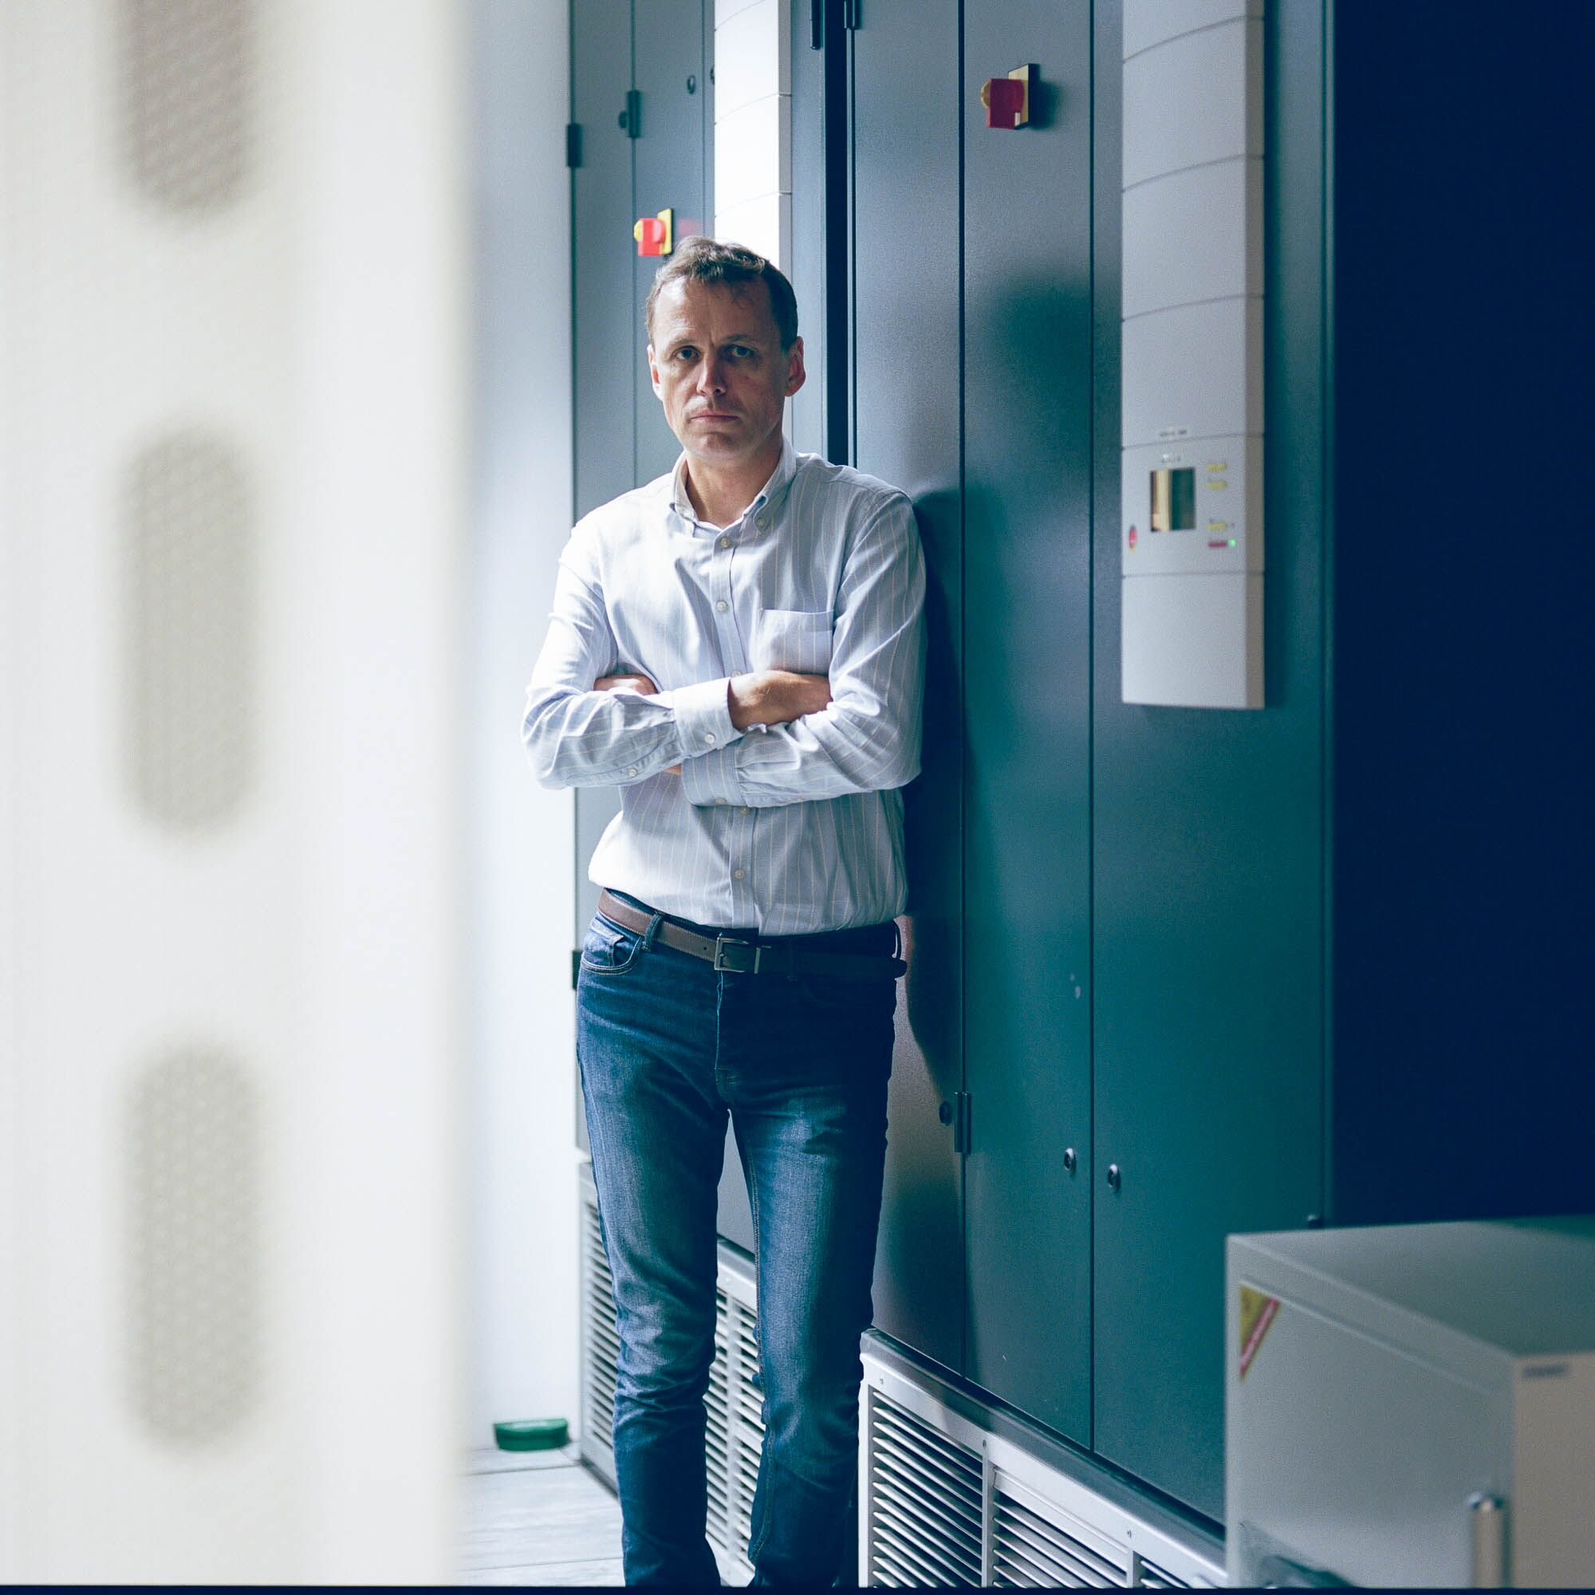
Let me introduce myself
Professor of Distributed Computing at the University of Westminster, London
Director of Research Centre for Parallel Computing
20 years experience in parallel and distributed computing, especially for the manufacturing and healthcare sectors and for scientific applications
Contact: t.kiss@westminster.ac.uk

Slide 3

What do Academics do?
They teach students at universities

Slide 4

What do Academics do?
They also do research
Research:
the systematic investigation into and study of materials and sources in order to establish facts and reach new conclusions (by Oxford Languages)

Slide 5
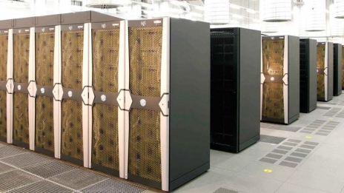

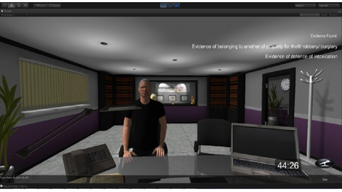


School of Computer Science and Engineering - Research vision
conduct high quality practice informed research with global impact by harnessing and translating fundamental knowledge in the discipline into practice, where appropriate through collaboration with end users from industry, the public sector and academia
achieve impact and research excellence by transcending the usual boundaries between science, engineering, medicine, as well as art, media and social sciences.

Slide 6
Research Centres/Groups
Centre for Parallel Computing: cloud orchestration and autoscaling, industry cloud applications
Distributed and Intelligent Systems: smart extreme-scale platforms with focus on performance, energy and security
Applied Digital Signal Processing and VLSI: digital signal and image processing, sensor networks, Internet of Things
Wireless Communications RGs: advanced design of circuits and subsystems, microwave circuits including filters and antennas
Health and Social Care Modelling: analytics and computing research assisting professionals in healthcare services
Computational Vision and Imaging Technology: image and video formation, processing, analysis, visualization, interpretation and evaluation
Serious Games at Westminster: effective serious games design and adaptation
Cyber Security Research: security challenges of emerging computing models and infrastructures such as cloud computing or Internet of Things
Cognitive Computing Research Group: semantic computing, pattern search and recognition, deep learning
Software Systems Engineering: programming principles, modelling methods, architectures, infrastructures

Slide 7
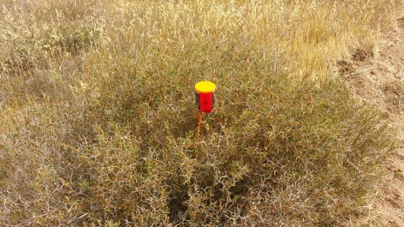
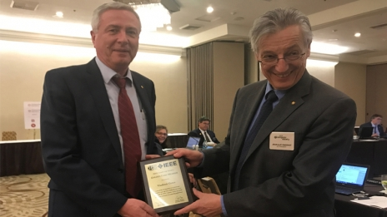
Recent successes
UNIVERSITY OF WESTMINSTER DEVELOPS INNOVATIVE FIREFIGHTING TECHNOLOGY TO DRAMATICALLY REDUCE FOREST FIRES
PROFESSOR VLADIMIR GETOV RECEIVES THE GOLDEN CORE AWARD FROM INSTITUTE OF ELECTRICAL AND ELECTRONICS ENGINEERS COMPUTER SOCIETY

Slide 8

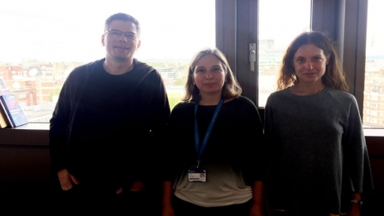
Funding successes
UNIVERSITY OF WESTMINSTER’S CENTRE FOR PARALLEL COMPUTING AWARDED MAJOR FUNDING TO INVESTIGATE IMPLICATIONS OF CLOUD COMPUTING SOLUTIONS IN HEALTHCARE
Dr Sophie Triantaphilidou and her team has recently been awarded major research contract to undertake research in image quality evaluation of mobile phone cameras

Slide 9
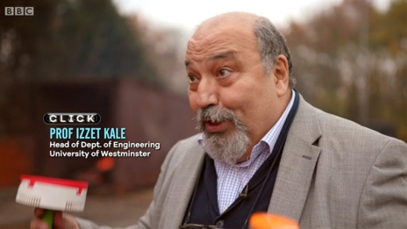
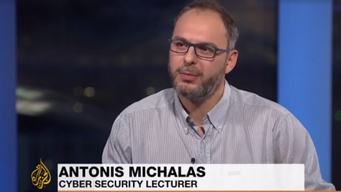
In the spotlight
BBC CLICK: PROFESSOR IZZET KALE SPEAKS ABOUT HIS RESEARCH ON WIRELESS FIRE SENSORS FOR FIREFIGHTING
DR ANTONIS MICHALAS ON UK GOVERNMENT AND INTELLIGENCE AGENCIES ACCESSING ENCRYPTING MESSAGING SERVICES

Slide 10
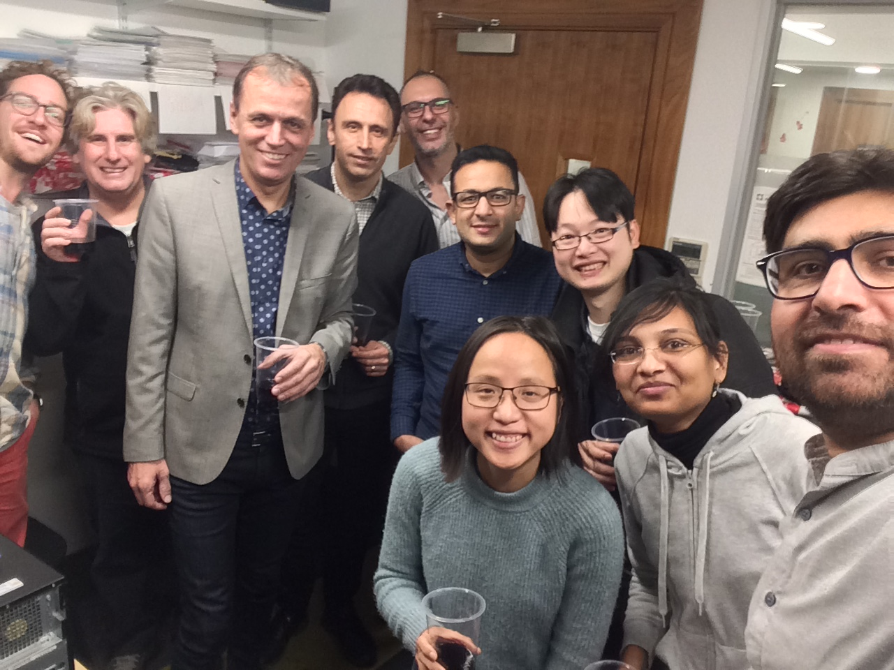
Centre for Parallel Computing
Research Centre for Parallel Computing
Focus on cloud-fog-edge computing – service orchestration
Application of clouds in manufacturing and healthcare
8 full-time and 3 part-time researchers, 3 academics
5 currently active European funded projects

Slide 11
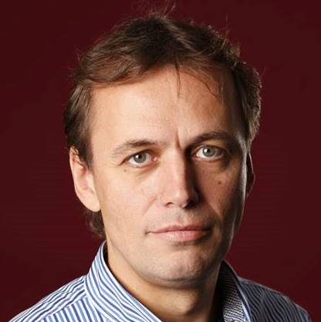

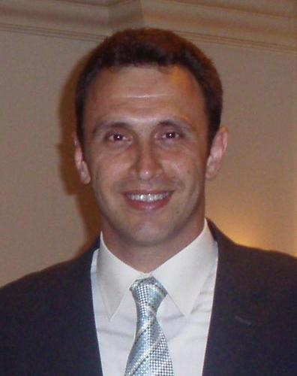
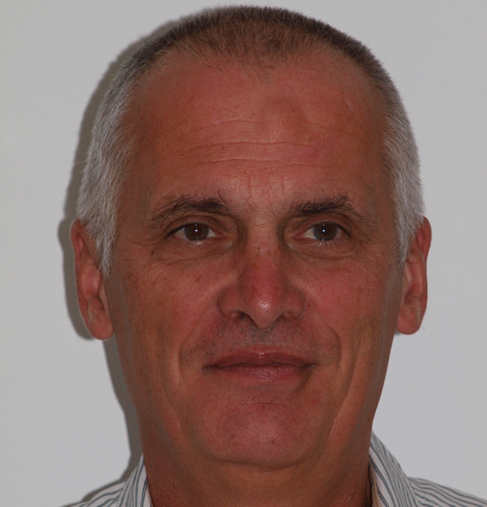

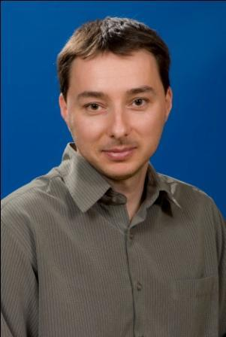







The Centre for Parallel Computing Team

Slide 12

What is Cloud Computing?

Slide 13


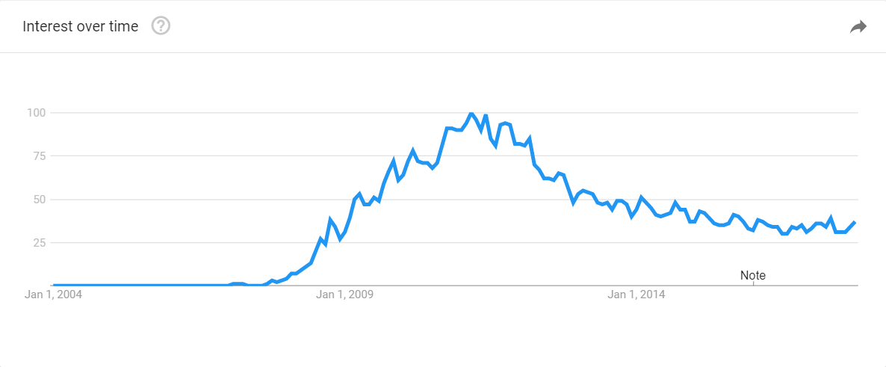
Living and working in the Cloud
Cloud computing – the next big thing after the Internet revolution?

Slide 14
We all have some ideas what the cloud is
But do YOU use cloud computing applications and/or services?

Slide 15



We all have some ideas what the cloud is But do you use cloud computing applications?
We all use Google mail – a cloud-based email service
Most of us use Apple iCloud – a cloud-based storage service
A few of us use Amazon Web Services (EC2) – a cloud service to rent virtual computers

Slide 16

So what is cloud computing?
Computing services are provided over the Internet (the Cloud) rather then locally on a user’s own machine.
computing resources (software, platform, infrastructure) are accessed as a service
paid for like a utility – pay-as-you-go

Slide 17
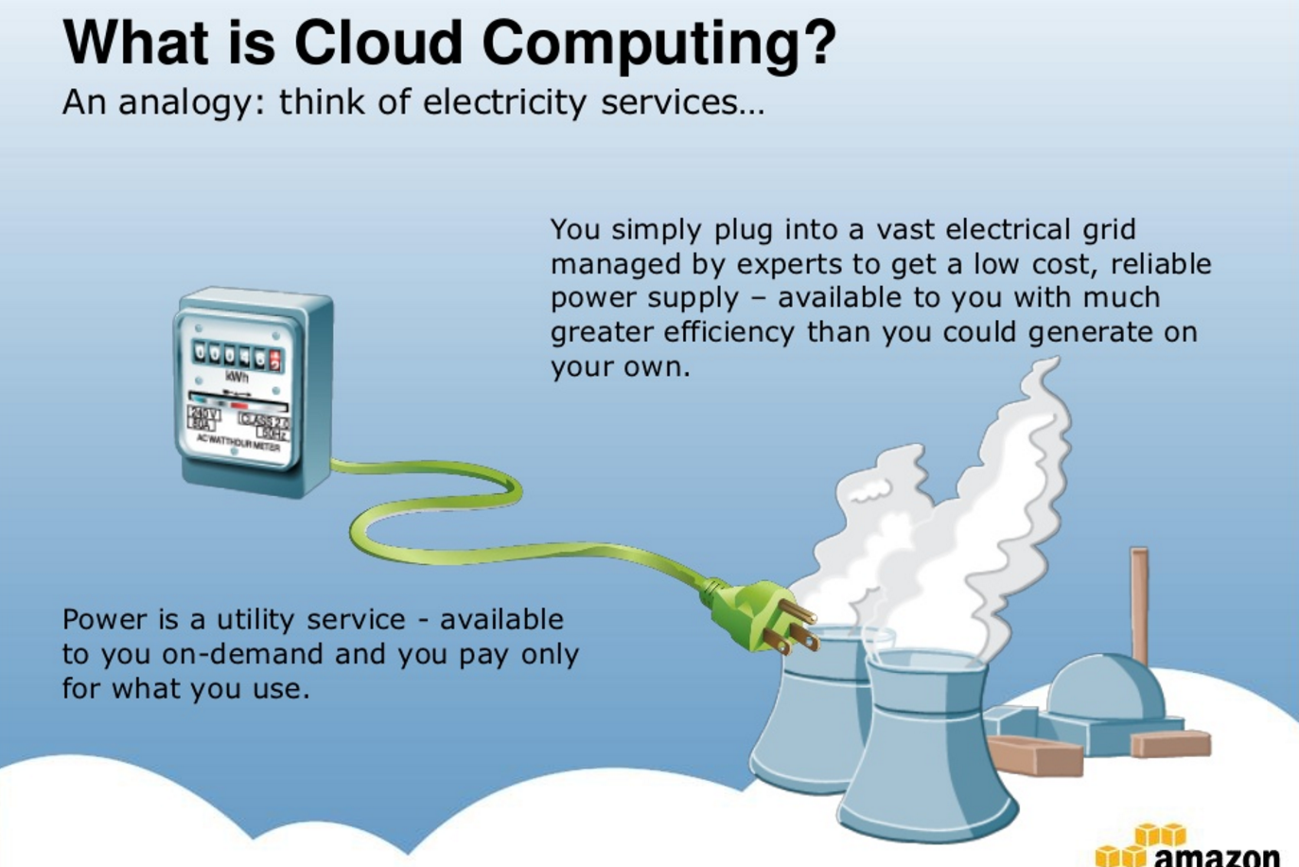
So what is cloud computing?

Slide 18
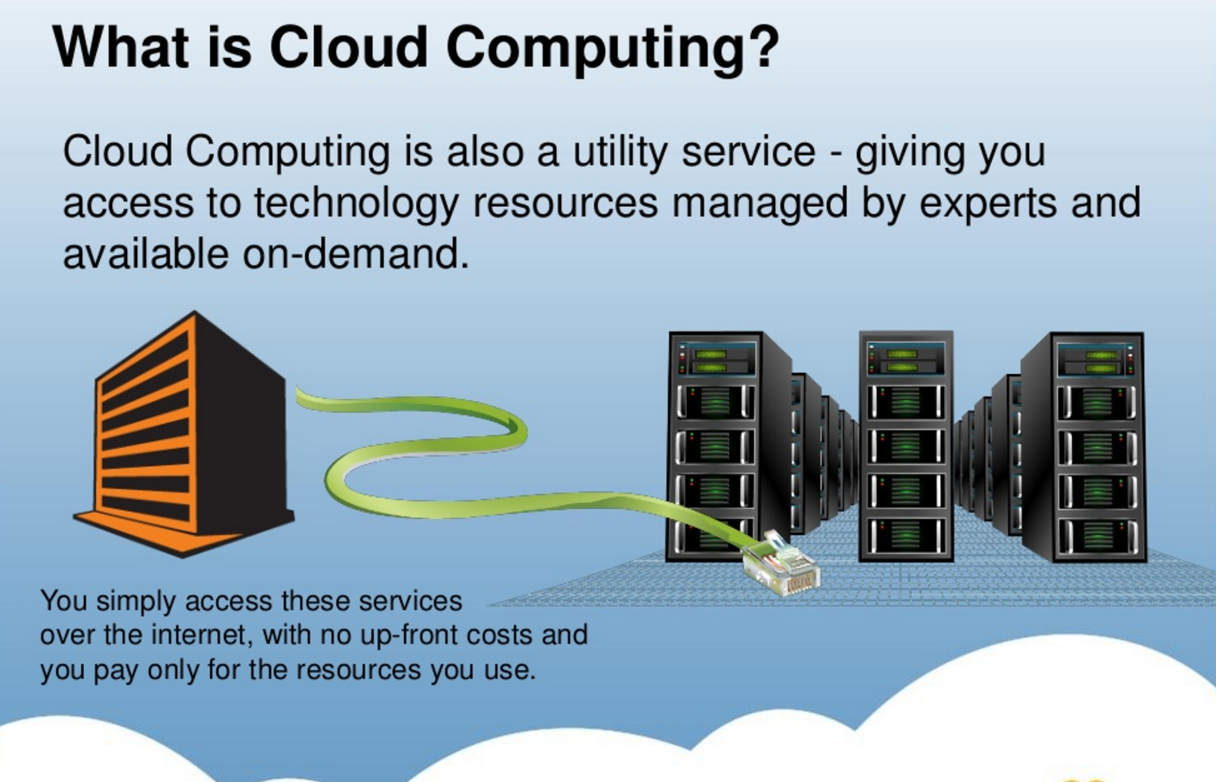
So what is cloud computing?

Slide 19
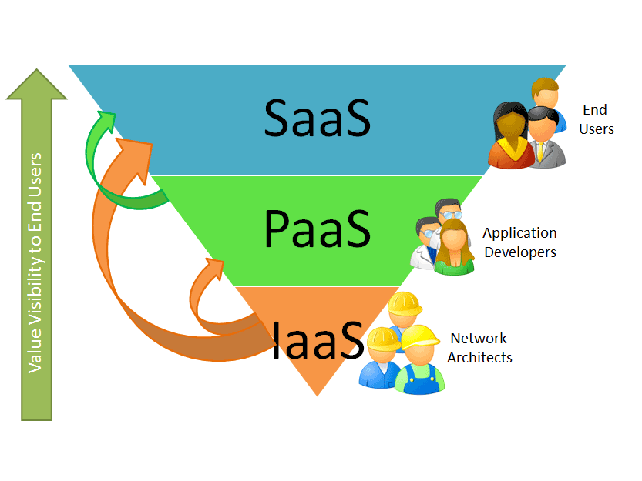
Cloud service models
Software as a Service
Platform as a Service
Infrastructure as a Service

Slide 20
SaaS – Software as a Service
Software delivery model - use provider’s applications over a network
Increasingly popular with SMEs
No hardware or software to manage
Service delivered through a browser in an “On-demand” fashion.
Reduces upfront costs, i.e. buying multiple licenses
Examples:
Your current CRM package is not managing the load or you simply don’t want to host it in-house….use a SaaS provider such as Salesforce.com
Your email is hosted on an exchange server in your office and it is very slow…outsource this using Google Mail.
You want to share music, books, apps with family members – iCloud Family sharing

Slide 21
PaaS – Platform as a Service
Deploy customer-created applications to a cloud
When the software needed to develop cloud applications are themselves provided in a “software as a service” fashion
Design and develop your own customized cloud application via tools inside the browser
Example:
You need to host a large file (5Mb) on your website and make it available for 35,000 users for only two months duration. Use Amazon CloudFront.
Create your custom Website using Google-sites

Slide 22
IaaS – Infrastructure as a Service
Rent processing, storage, network capacity, and other fundamental computing resources
Serves the hardware needs of an organisation
Examples:
You want to run a batch job but you don’t have the infrastructure necessary to run it in a timely manner. Use Amazon EC2 (Elastic Compute Cloud) to rent computers.
You want to start storage services on your network for a large number of files and you do not have the storage capacity…use Amazon S3 (Simple Storage Service)

Slide 23
Cloud deployment models
Public Cloud
Services sold publicly via the Internet
The cloud infrastructure is made available to the general public or a large industry group, and is owned by an organization selling cloud services
E.g. Amazon Web Services, Google Apps, Apple iCloud
Private Cloud
The cloud infrastructure is operated solely for an organization
proprietary network or a data-center that supplies hosted services to a limited number of people
E.g. Faculty of Science and Technology OpenStack Private Cloud to support teaching and research
Community cloud.
The cloud infrastructure is shared by several organizations and supports a specific community
Possible model for academic clouds in the future
Hybrid cloud
Composition of two or more clouds (private, community, or public)
E.g. cloud bursting for load-balancing between clouds – extending in-house cloud with public resources

Slide 24




Why is cloud computing important?
Cloud computing changes the way we consume IT completely
No need to buy expensive hardware and software licenses
No need to operate and maintain complex IT infrastructure locally
Eliminates upfront investment costs – rent instead of buy
Extremely attractive for all companies,
especially for small and medium sized enterprises (SMEs)

Slide 25
Reality check
Take-up of cloud computing in industry is still low
Take-up by SMEs is especially low
Reasons:
Lack of awareness
Lack of expertise
Knowledge gap
Security concerns
Clear opportunity to make significant impact with research!

Slide 26
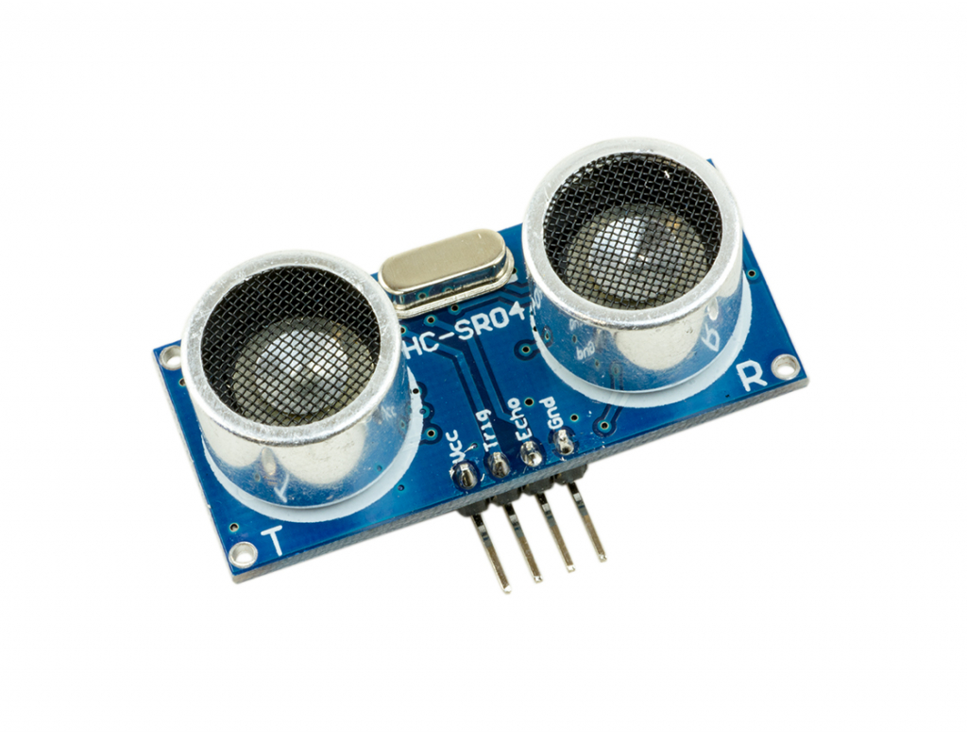
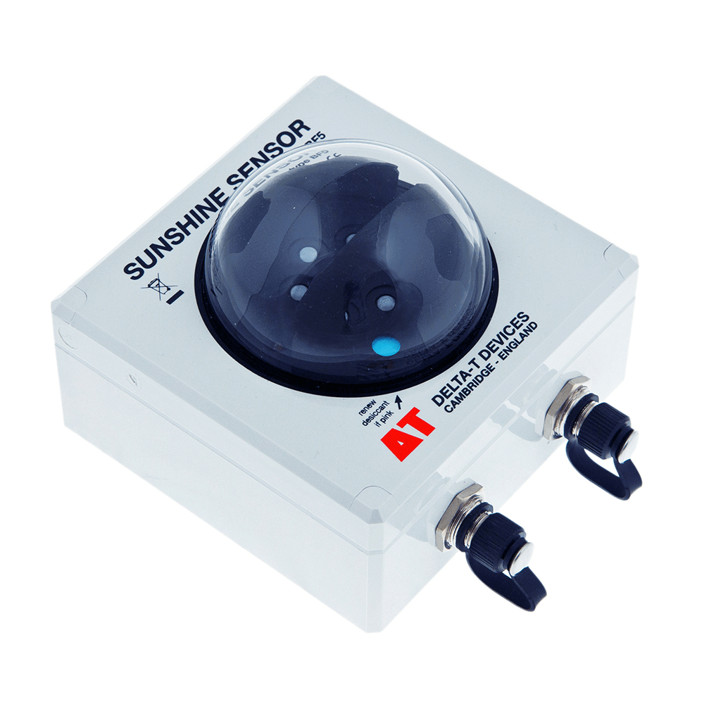

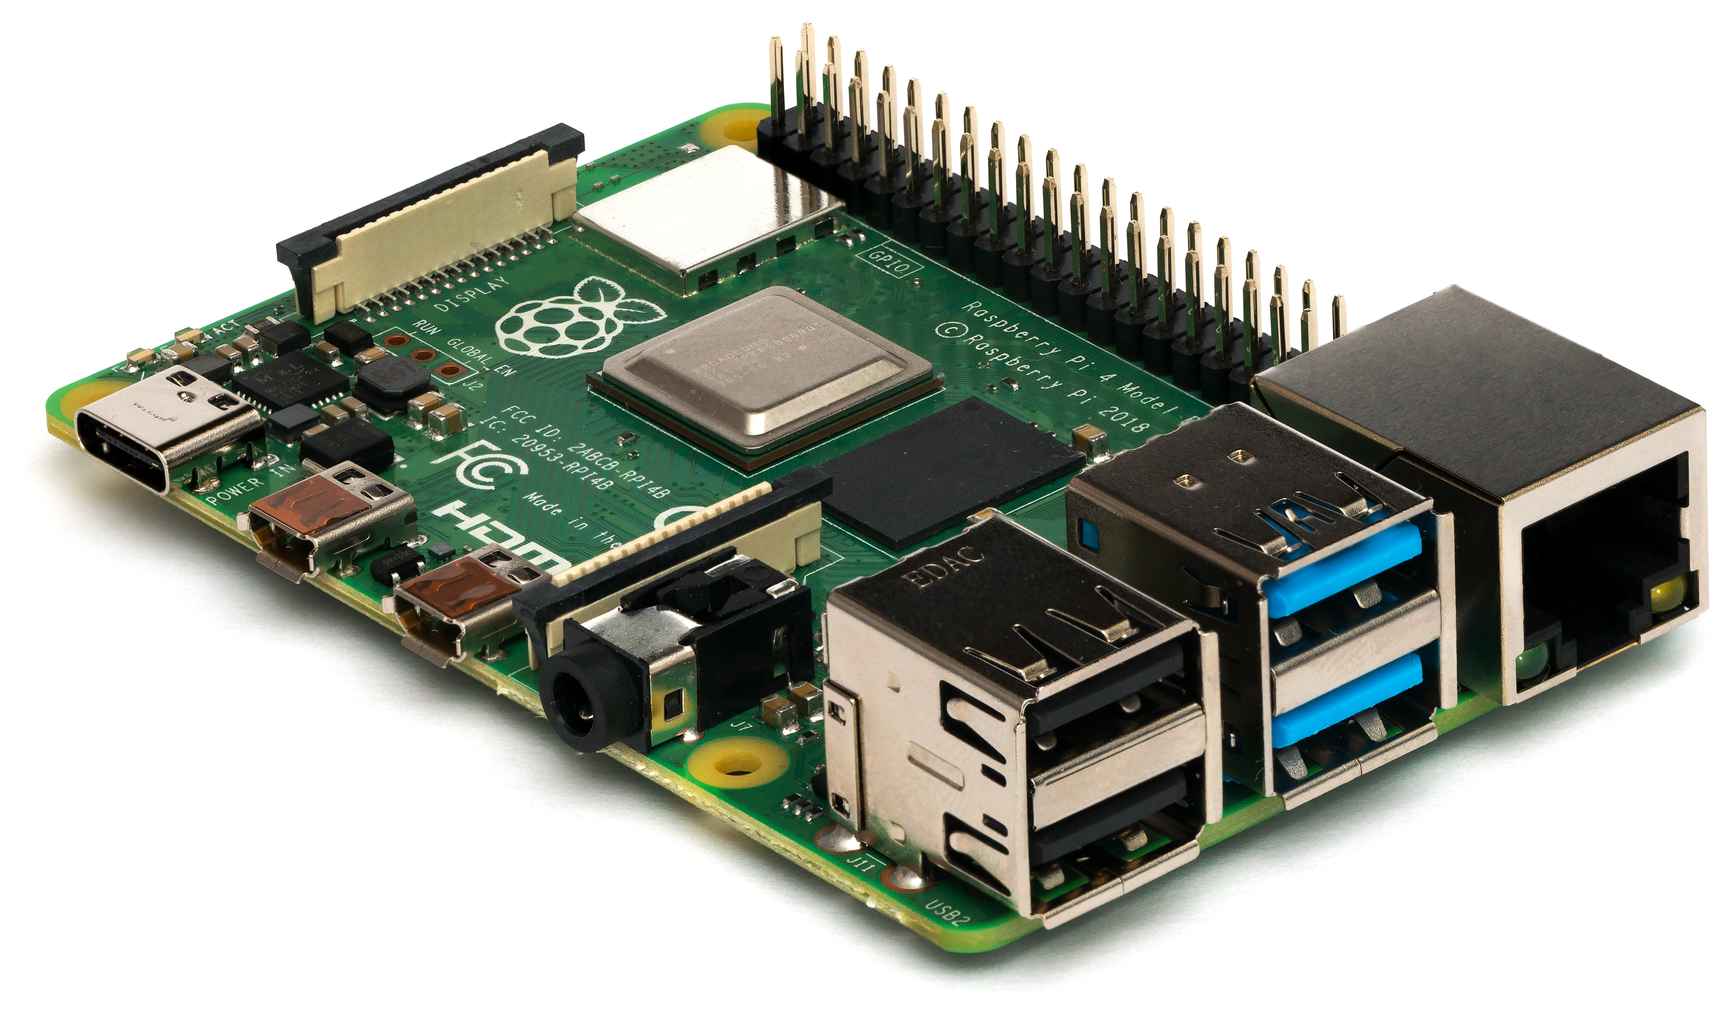






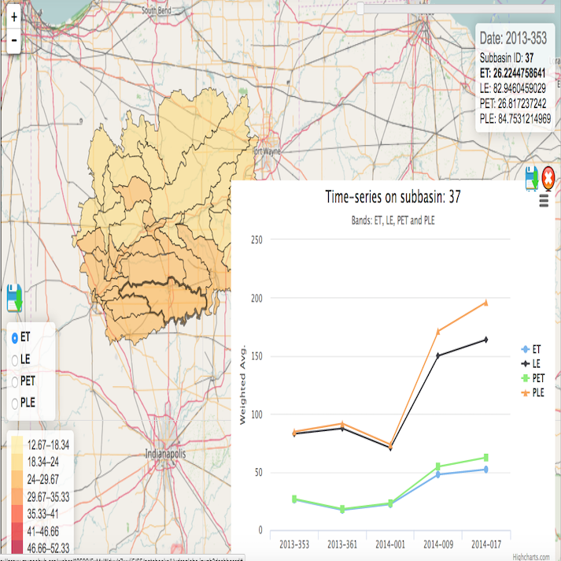
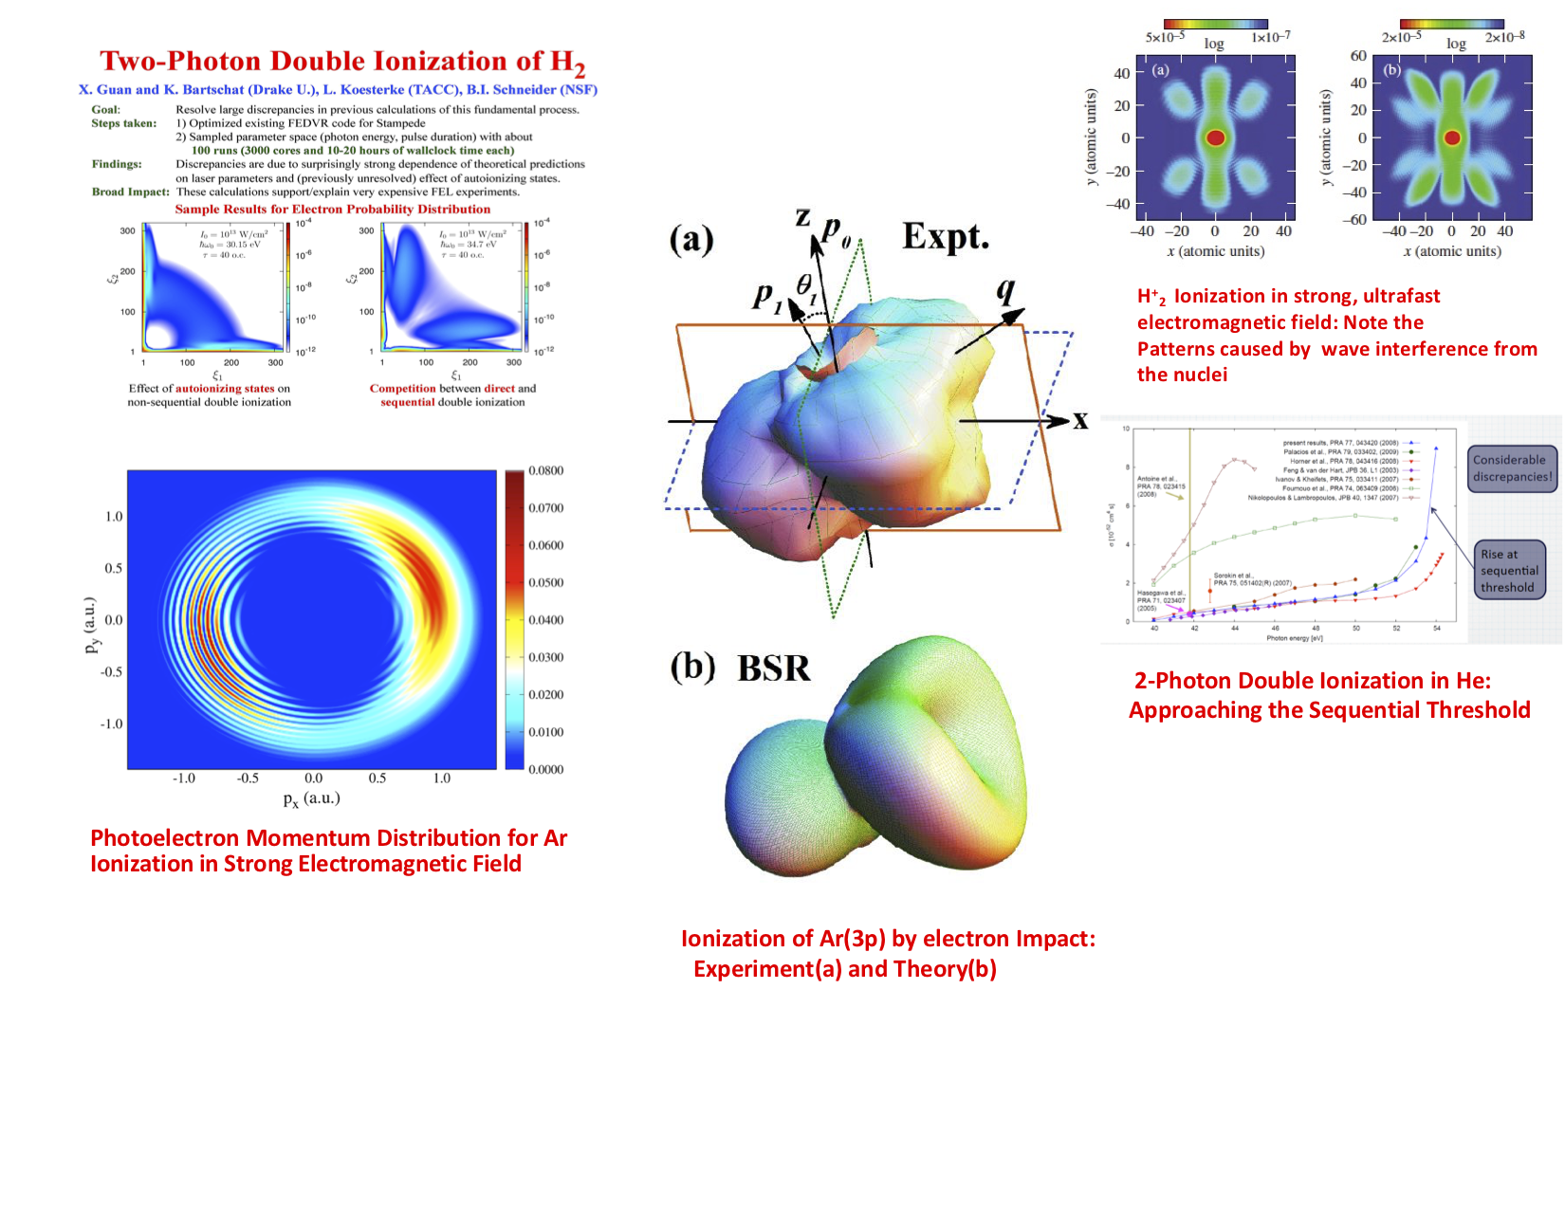
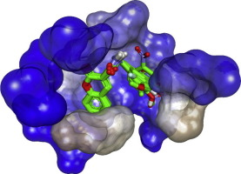

Some cloud computing challenges
?
?
?
?
?
?
?
?
?
?
?
?
?
?

Slide 27
What challenges are we addressing?
Take-up of clouds is still relatively limited - complex to implement/deploy solutions
Multi-cloud applications are rare – vendor lock-in
Elasticity and dynamic auto-scaling at the level of applications is limited
Dynamic and scalable extension towards edge and fog is a challenge
Security concerns imposed by virtualization and third party provisioning
Integration with science/business gateways is required to make all this available for end-users

Slide 28



Scalable Cloud Applications for Manufacturing
CloudiFacturing - Cloudification of Production Engineering for Predictive Digital Manufacturing
1st October 2017 - 31st March 2021
A genetic execution platform and digital marketplace for manufacturing SMEs
Over 80 partners implementing 21 application experiments
Funding: 8.7 million
More information: https://www.cloudifacturing.eu/
DIGITbrain
1st July 2020 - 31st December 2023
Extending the digital twin concept to Digital Product Brain
Memorising capacity to cover full industrial product life-cycle
Over 80 partners implementing 21 application experiments
Funding: EUR 8.3 million
https://digitbrain.eu/
CO-VERSATILE
1st November 2020 - 31st October 2022
Applying scalable simulation for quick restructuring of manufacturing lines
Triggered by the COVID-19 pandemic
Implementing 7 Manufacturing Settings to manufacture vital medical supply
Funding: EUR 5.4 million

Slide 29



So how can cloud computing help SMEs? A typical case-study
Cloud-based simulation for microbreweries
Large breweries are long standing clients of simulation - ~50 large breweries around Europe use simulation
Application areas: brewing, packing, distribution, supply chain
In contrast there are approximately 1,350 UK Craft brewers (microbrewers) and an estimated 15,000 across the EU - significant SME manufacturing sector
Approach:
develop a simulation template that can be used by multiple microbreweries from a simulation one-stop-shop
offer on a pay as you go basis
Optimise scheduling so that beer is always consumed in an optimal time window

Slide 30
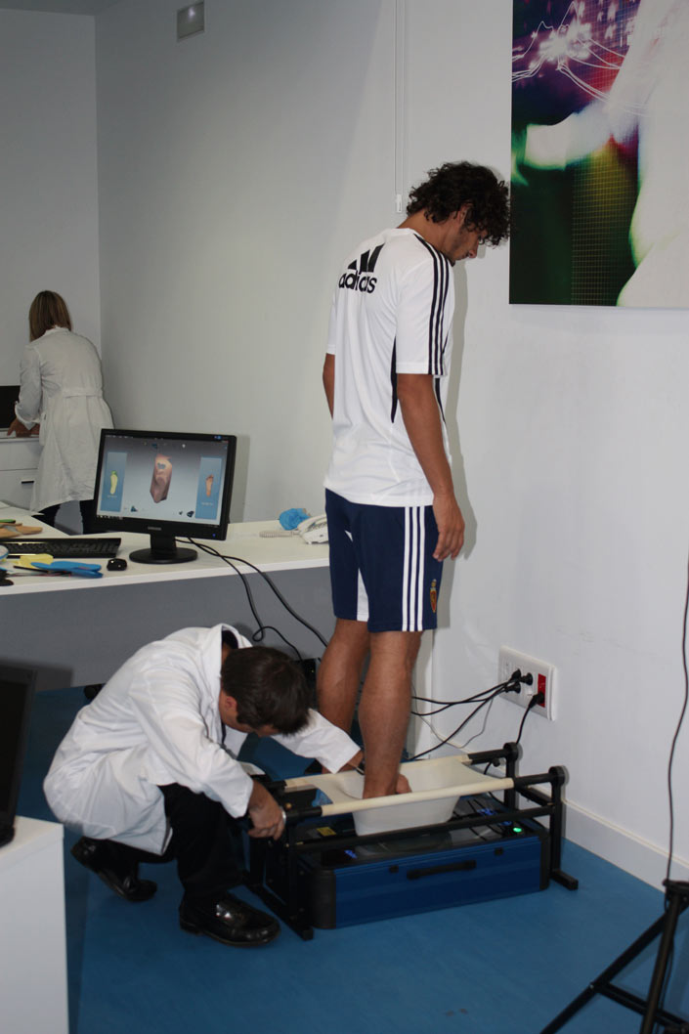
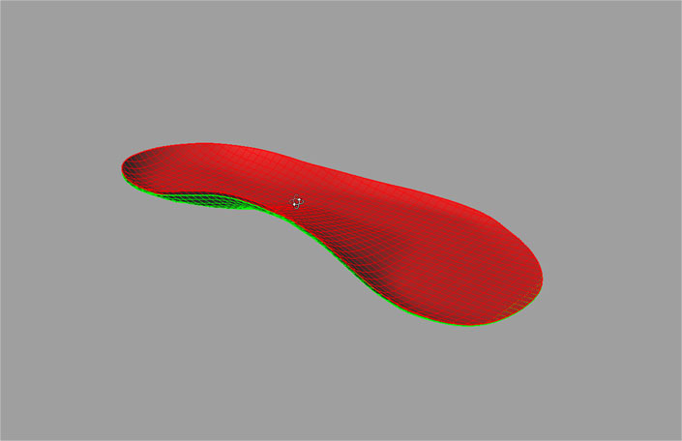
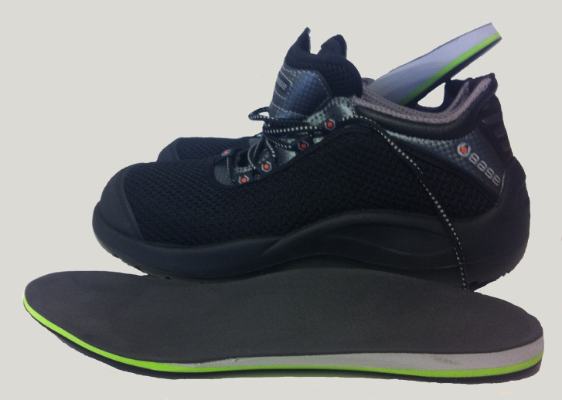
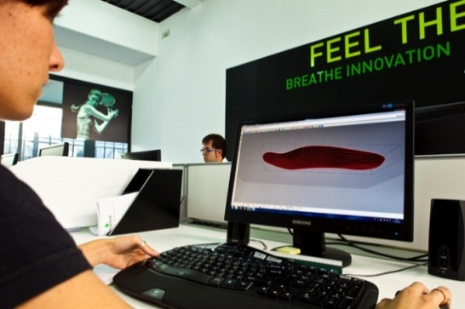
Application example Cloud computing to design customised insoles and safety shoes
Base Protection: Italian SME that manufactures industry-leading comfortable and technologically advanced safety shoes.
Podoactiva: Spanish SME that designs and manufactures tailored shoe insoles
Ingecon: Spanish technology company that developed 3D Scan Insole Designer software
Istituto Ortopedico Rizzoli: Italian centre with an internationally excellent reputation in orthopaedic health care

Slide 31
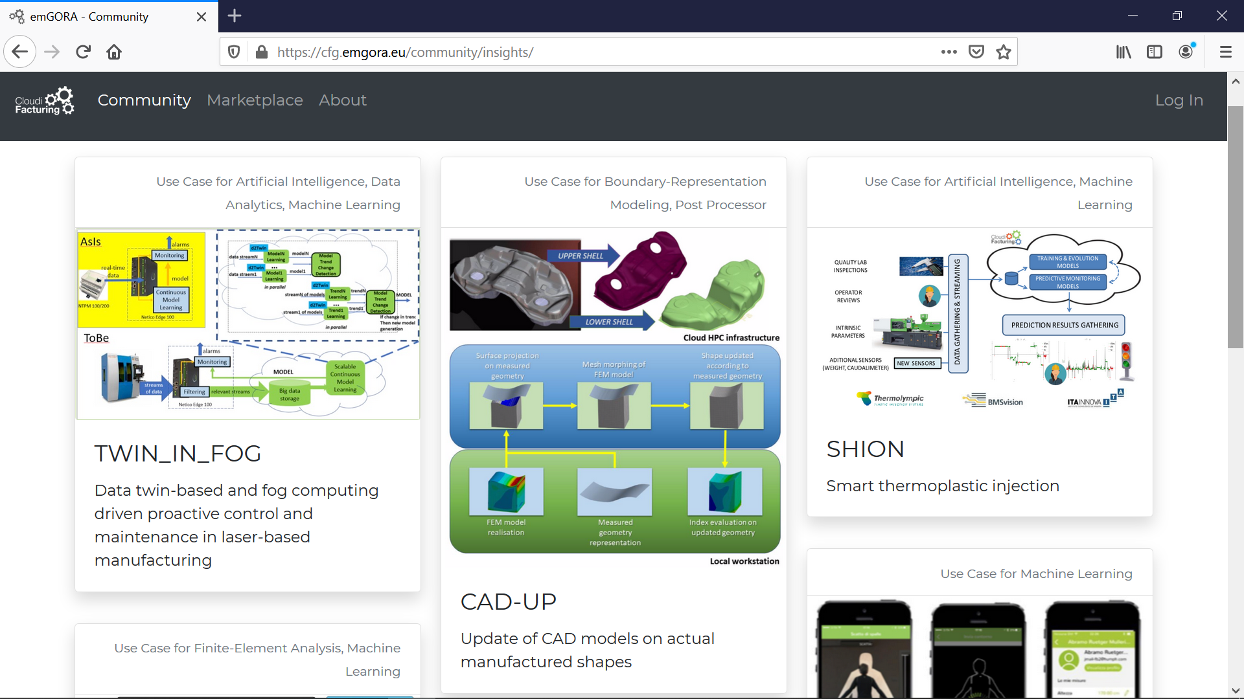
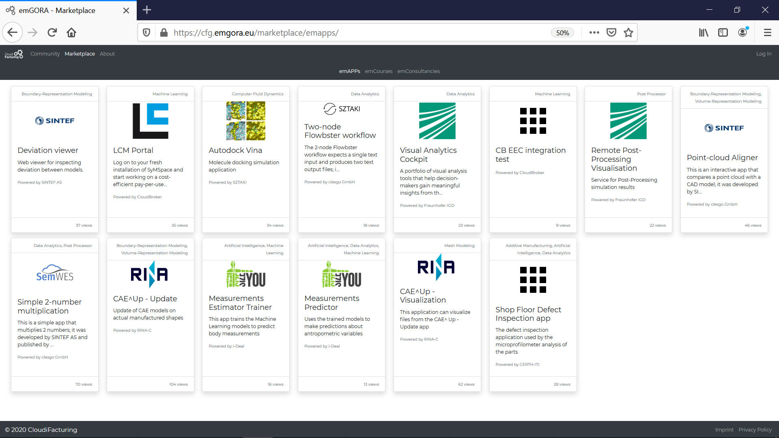
The CloudiFacturing Marketplace - emGORA

Slide 32











Secure scalable applications in healthcare
ASCLEPIOS: Advanced Secure Cloud Encrypted Platform for Internationally Orchestrated Solutions in Healthcare
1st December 2018 - 30th November 2021
Utilise modern cryptographic approaches to build a cloud-based eHealth framework that protects users’ privacy and prevents both internal and external attacks.
Deploy and manage healthcare applications and ASCLEPIOS Security Framework components with MiCADO
Funding: EUR 4.8 million
Further information: https://www.asclepios-project.eu/

Slide 33

ASCLEPIOS Demonstrators
Stroke Acute Care
In- and Outpatient Sleep Medicine
Monitoring and Benchmarking of Antibiotic Prescription
EMRs on secure cloud infrastructure
Attribute-based encryption for dynamic data access authorization and revocation to patient information during the acute phase
Privacy-preserving machine-learning for predictive models
Flexible access control and privacy-preserving techniques for data sharing in research
Extension of collaboration platform developed by CBMI
Facilitate quality control and analysis of bio-signal data on cloud infrastructure
Direct communication between different actors (patients, technical & medical staff, physicians, researchers)
Fine-grained data access policies for patient-related data
Privacy-preserving statistical computations for improved security and privacy of GPs
Searchable encryption for sub-dataset querying and functional encryption for statistical computations
Implementation of data access policies and better access control on data for GPs and patients

Slide 34




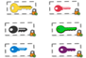
ASCLEPIOS Framework
Gateway
Doctors
Patients
Healthcare applications and ASCLEPIOS services deployed and managed by MiCADO
Crypto Layer
Policy Enforcement Layer
Healthcare applications
Modern Cryptographic techniques:
Functional enc.
Symmetric Searchable enc
Attribute-based enc.
Access and encryption policies management editor
Identify Emerging Threats
Input: Encrypted data
Analytics layer
Manage Security Incidents
Output: Final result of FE
Policy interpretation mechanism
Raise Security awareness
Functional encryption
TEE
Secure Admin Data
Traditional Cryptographic techniques:
Symmetric enc.
Asymmetric enc
Hash functions
Context-aware attribute-based access control enforcement mechanism
TEE
KeyTray: Store symmetric keys encrypted with ABE
Encrypted Database
(SSE)
TEE
TEE
Attestation server
Revocation authority
Cloud providers

Slide 35
Thank you for your attention!
Any questions?
Please come to the Q&A on Monday

